Slide 1
Connection Management

Slide 2
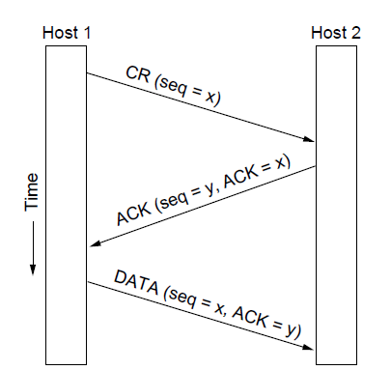
Connection Establishment
Three Way Handshake

Slide 3
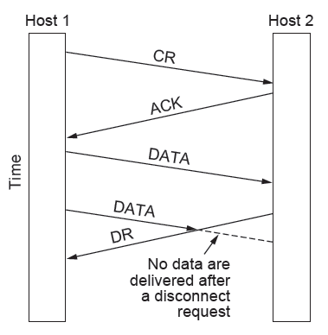
Connection Release (Asymmetric)
One-sided, abrupt connection termination could lead to loss of data

Slide 4
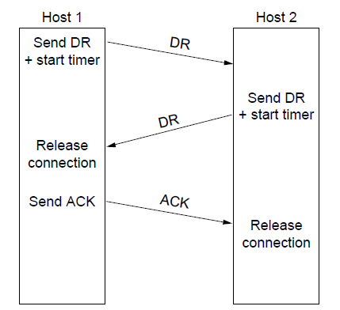
Connection Release (Symmetric)
Normal (graceful) connection termination

Slide 5
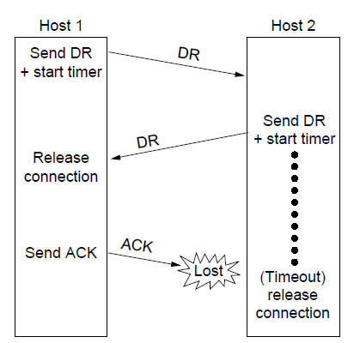
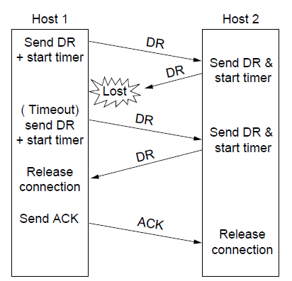
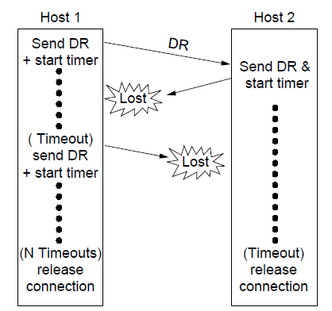
Connection Release
Error cases handled through ACKs, timers and retransmissions

